Slide 1
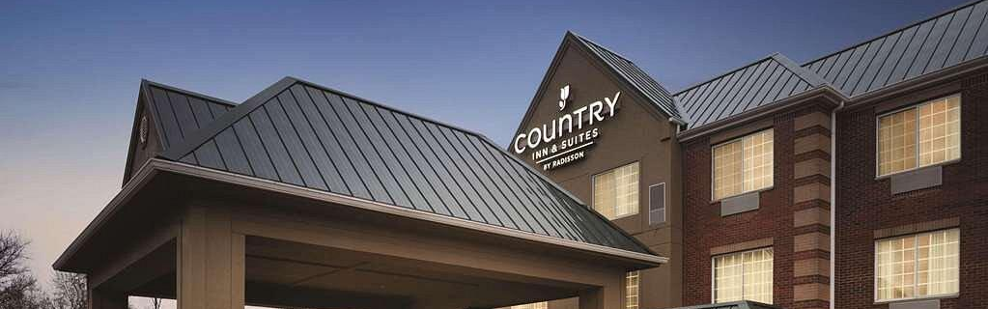
Hotel Booking Cancellation Analysis
The Project Overview
Michael Albers, Raegan Storin, Aubrey Kranz

Slide 2

INTRODUCTION
Overbooking is a revenue management technique used by hotels to better accommodate to last minute cancellations. However, hotel overbooking can decrease customer satisfaction and negatively impact reputation while underbooking reduces potential revenue.

Slide 3
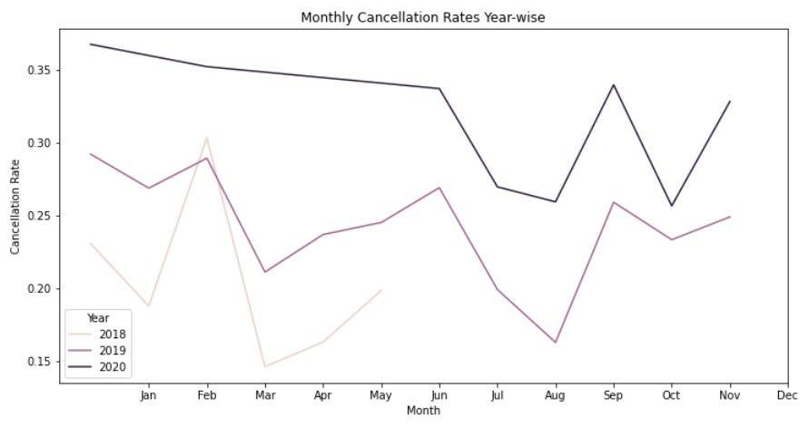
THE PROPOSAL
?
Our hypothesis is that we will be able to more accurately predict a hotel’s optimal booking capacity by taking into account known factors of historical data. We can then use this model to improve the method of booking or cancellation policies to accurately accomodate for booking cancellations.

Slide 4
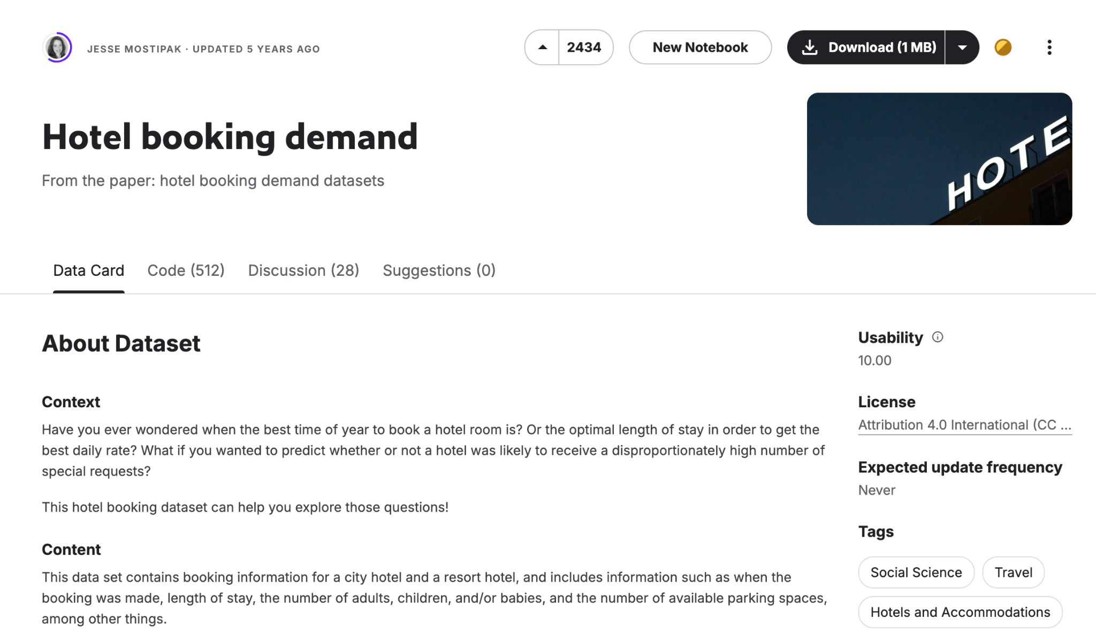
DATA
We were able to find a dataset from Kaggle containing booking information for a city hotel and a resort hotel, including details like booking lead time, cancellation policies, customer types, and 28 various other factors. Within the data there are 40,060 observations of the resort hotel and 79330 observations of the city hotel.

Slide 5
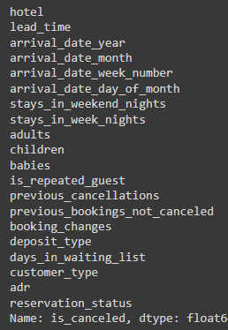
METHODS
We then performed some basic cleaning after uploading and reading the data into google colab using pd.read_csv().
This included…
Dropping missing values
Splitting the information into two separate dataframes for city hotel and resort hotel
Removing variables unlikely to contribute significantly
Converting various categorical variables to numeric.
Ex. (deposit_type: Replaced 'No Deposit', 'Non Refund', and 'Refundable' with 0, 1, and 2)
We will discuss more when we demonstrate our code

Slide 6
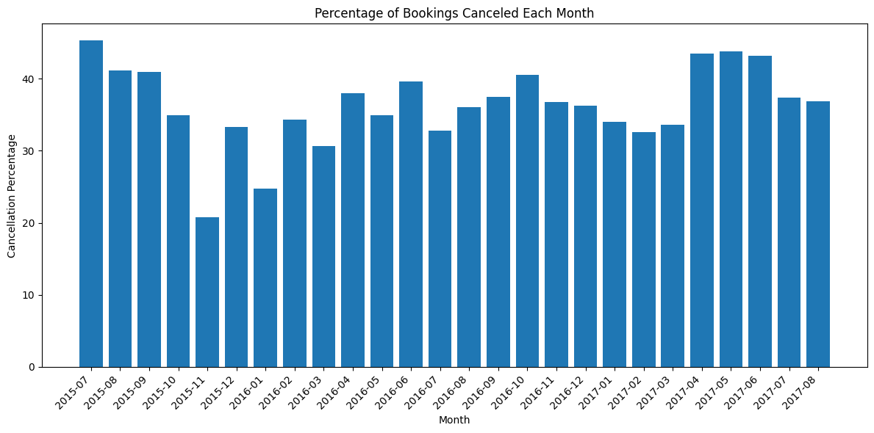
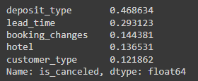
PRELIMINARY ANALYSIS
Preliminary analysis of our data provided us with some insight on relevant predictor variables and a baseline idea of what we should expect during the modeling phase. As seen below, a minimum of 20% of bookings were canceled in a given month, a maximum of 45%, and an average of around 35%.

Slide 7
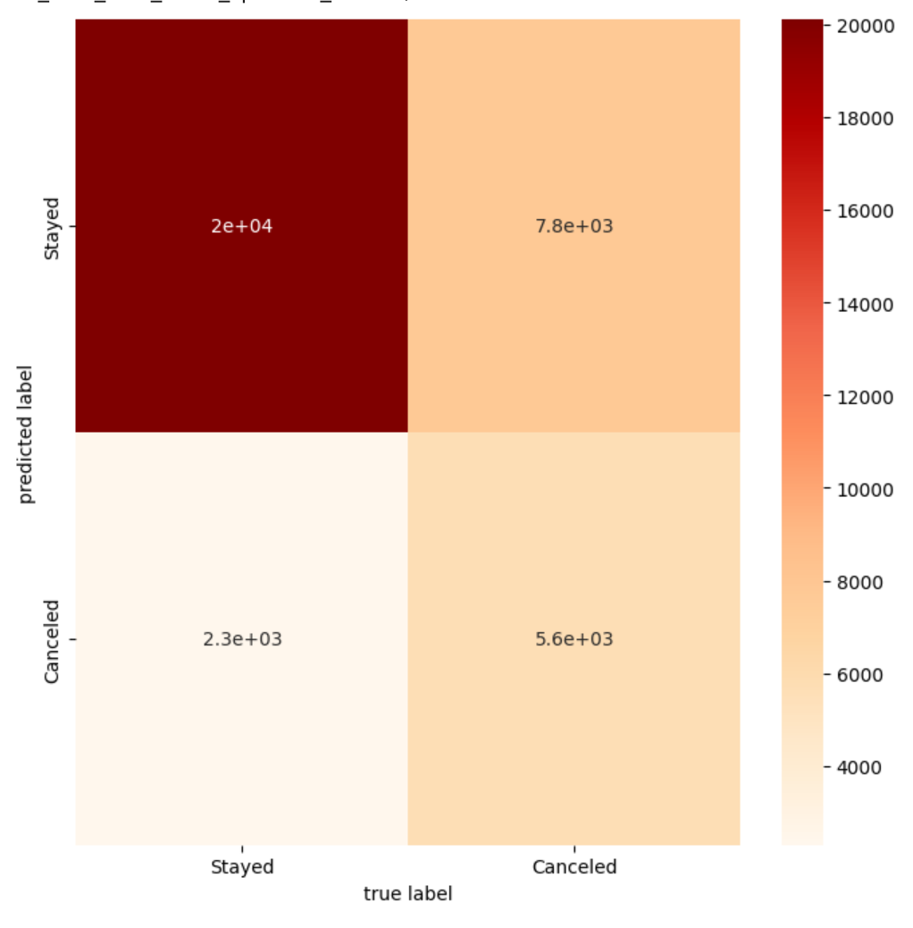
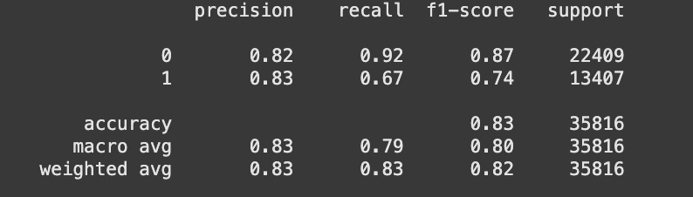
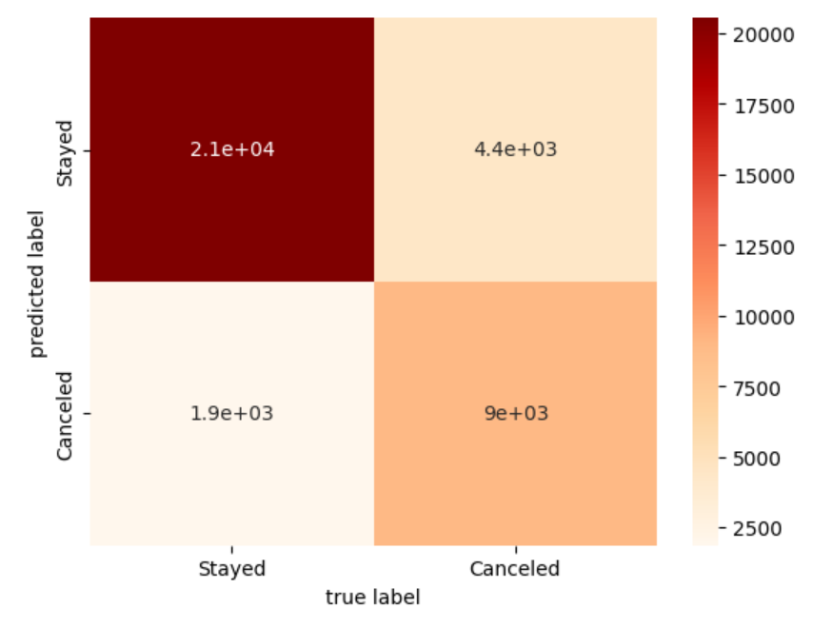




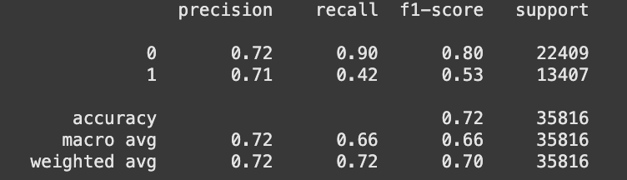
LOGISTIC REGRESSION AND RANDOM FOREST CLASSIFICATION
Categorical Prediction Models
After testing our two models, Logistic regression(LR) and random forest classification(RFC), RFC performed significantly better at predicting booking cancellations. With 82-83% accuracy across city and resort hotels, this was a large improvement over the minimum expected baseline of simply predicting 66% of bookings as non-cancelled based on historical trends.
Random Forest Classifier
→
Logistic Regression
←

Slide 8
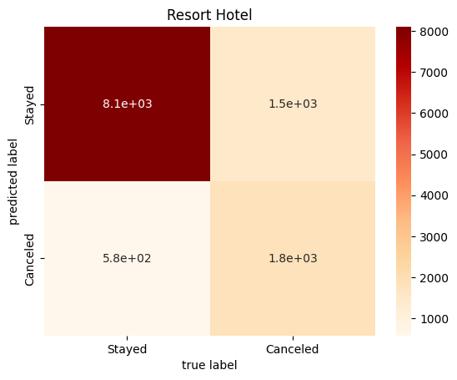
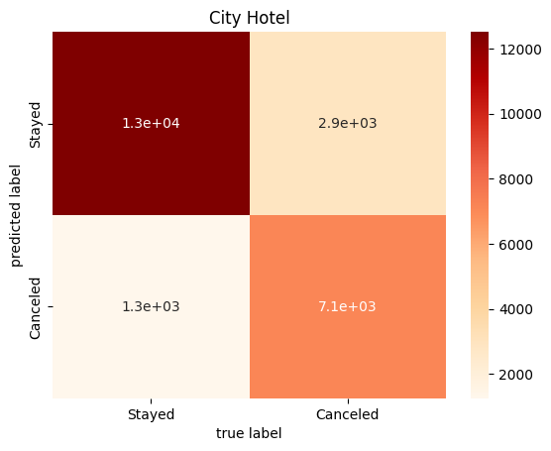
FURTHER RESULTS
To further test our model we decided to split the data between the resort and city hotels to compare accuracy. As seen below the Resort Hotel performed slightly better.
Resort Hotel
City Hotel

Slide 9
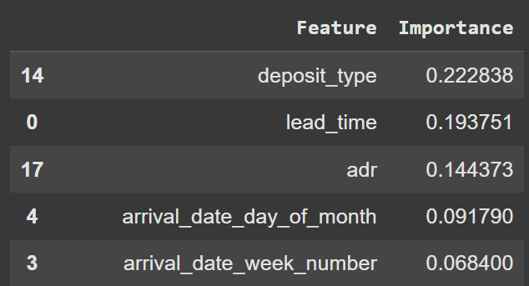
POST ANALYSIS
Our initial exploratory data analysis examined the correlation coefficient of various features to cancellation.
In contrast, during the predictive modeling, the features with the greatest importance were deposit type, lead time, and average daily rate(adr), as well as arrival date.
This indicates that the price of the rooms as well as what time of year the booking is placed for both play a more significant role in cancellation likelihood than previously expected.

Slide 10

DISCUSSION
Main Points
Our results align with previous studies on hotel booking cancellation, confirming that lead time and deposit types significantly affect cancellation rates.
The importance of room price as a key feature highlights the role that financial factors play in customer decisions.
The weak correlation of customer type was surprising, and indicates potential for further investigation.
Random Forest Classifier(RFC) consistently outperformed Linear Regression(LR), which led us to select it as our primary predictive model.

Slide 11

CONCLUSION
1
Hotel overbooking can decrease customer satisfaction and negatively impact reputation while underbooking reduces potential revenue. Therefore, The goal would be to minimise hotel underbooking without overbooking and exceeding capacity.
2
We can improve the method of booking or cancellation policies to accurately accomodate for booking cancellations by taking into account known factors of historical data.
3
This project developed a machine learning model that successfully predicts hotel booking cancellations with high accuracy. The results demonstrate the importance of data-driven decision making in hotel operations.
Future Application?

Slide 12
THANK YOU

Slide 13
Questions?

Slide 14
SOURCES
Have a good break! :)
Antonio, Nuno, et al. “Predicting Hotel Bookings cancellation with a machine learning classification model.” 2017 16th IEEE International Conference on Machine Learning and Applications (ICMLA), Dec. 2017, pp. 1049–1054, https://doi.org/10.1109/icmla.2017.00-11.
Chen, Shuixia, et al. “Prediction of hotel booking cancellations: Integration of machine learning and probability model based on interpretable feature interaction.” Decision Support Systems, vol. 170, July 2023, p. 113959, https://doi.org/10.1016/j.dss.2023.113959.
Jishan, Md Asifuzzaman, et al. “Hotel Booking Cancellation Prediction Using Applied Bayesian Models.” arXiv.Org, 23 Oct. 2024, arxiv.org/abs/2410.16406. Accessed 13 Nov. 2024.
Mostipak, Jesse. Hotel Booking Demand. Kaggle, https://www.kaggle.com/datasets/jessemostipak/hotel-booking-demand. Accessed 17 Oct. 2024

